Slide 1
From Casual To Customer
A Bike Share Company Case Study
Nathaniel Nete-Sie Williams Jr.
12/19/22
12/25/2022 (Updated)
Notes:
The purpose of this case study is to try and figure out how to maximize the number of annual memberships for the fictional company "Cyclistic" by trying to understand how casual riders (those who just purchase a single ride pass) and annual members …use Cyclistic bikes differently.
I’ve compiled 12 months of casual and annual member rider data from Divvy Bike share companies open public dataset. (this is the real company this fictional company is based off)
I’ll be using the power of data to help build somewhat of a customer profile of our casual riders. This should help the marketing team to craft messages that address their specific challenges and needs so we can convert them to annual members.
We need to learn more about them. So what we learn will inform us on what form of digital marketing we’ll recommend and what message we’ll be trying to convey.

Slide 2
Contents
Questions & Initial Hypothesis
Metrics
Average Trip Duration
Busiest Days of the Week
Busiest Time of the Day
Top Trip Locations
Key Takeaways
Conclusion
Notes:
So the Goals for Our Discussion today will be to look at…
The Business task questions we’re trying to answer and my initial hypothesis on them.
The metrics I choose that I feel will help me answer those business questions
First one being the average trip duration of our casual and annual member riders
Second one being the busiest days of ridership doing the week
Third one being when our ridership is the busiest during the day for each of our casual and annual riders
And, the Top trip start locations of both our riders
Finally we’ll wrap up what key insights we’ve learned
Then go over some suggestions based on the data we’ve gone through

Slide 3
Questions & Initial Hypothesis
1) How do casual members and annual members use Cyclistic bikes differently ?
Bikes used fewer times a year than annual members
Pay more per ride on average
2) Why would causal riders buy Cyclistic annual memberships ?
Find value in membership benefits
3) How can Cyclistic use digital media to influence casual riders to become members ?
Use data to market directly to our audience
Notes:
I assume casual riders use the bikes fewer times a year than annual members
but most likely pay more per ride on average…Assuming there’s some cost savings per ride for annual membership.
Casual members would buy annual memberships if they realized how cost effective an annual membership was.
Using the data we could send out specific social media campaigns based on certain demographic information , that highlight the savings of an annual membership.

Slide 4

Process
1. ‘‘ride_length’
2. WEEKDAY
3. ‘hour_of_day’
4. Exclude data from stolen bikes
Notes:
Initially, there were many null values in the start and end location columns so I decided not to focus on metrics based on those fields, early on . The consistent fields were ride_id, the type of bicycle used for each trip, Start and end times of each trip ,start and end latitude/longitude coordinates, and what type of member the rider was ( casual or annual).
So in Excel I decided to start off finding each trips 'ride_length' by subtracting the end ride time by the start ride time.
Next, I decided to single out the day of the week from each ride id's start time in order to get a feel on how rides were going in a Work Week/End format. Using the WEEKDAY function I was able to do that,starting my week on Sunday. I named the column 'day_of_week'
Next I singled out the time of day in hours(AM/PM) because I was hoping to find out if rush hour effects casual riders differently than annual members. Singling out the time of day in its own column will make it easier to group data this way down the line. I named this column 'hour_of_day'
Initial observation...I noticed that only casual members used a "docked_bike" besides the available electric and classic bike that annual members were using. It seemed only casual riders were using these bikes, in addition to the other 2. Strangely enough some of the trip duration lengths lasted multiple days and had null values for their end of ride gps location (lat/long).
After further investigation into these, long ride duration and no end gps location rides... I found multiple articles of bike share theft in the Chicago area where this dataset represents. So for now we will filter out data that seems to look like a stolen bike (has no end of ride gps and the trip duration is over 24 hours). I want to focus on converting the casual riders that aren't stealing bikes lol.
There were some negative ride times as well ( where start time of the ride is actually greater than the end time). It might be a way for bike techs to show it’s been serviced but I don't have a primary source to verify this

Slide 5
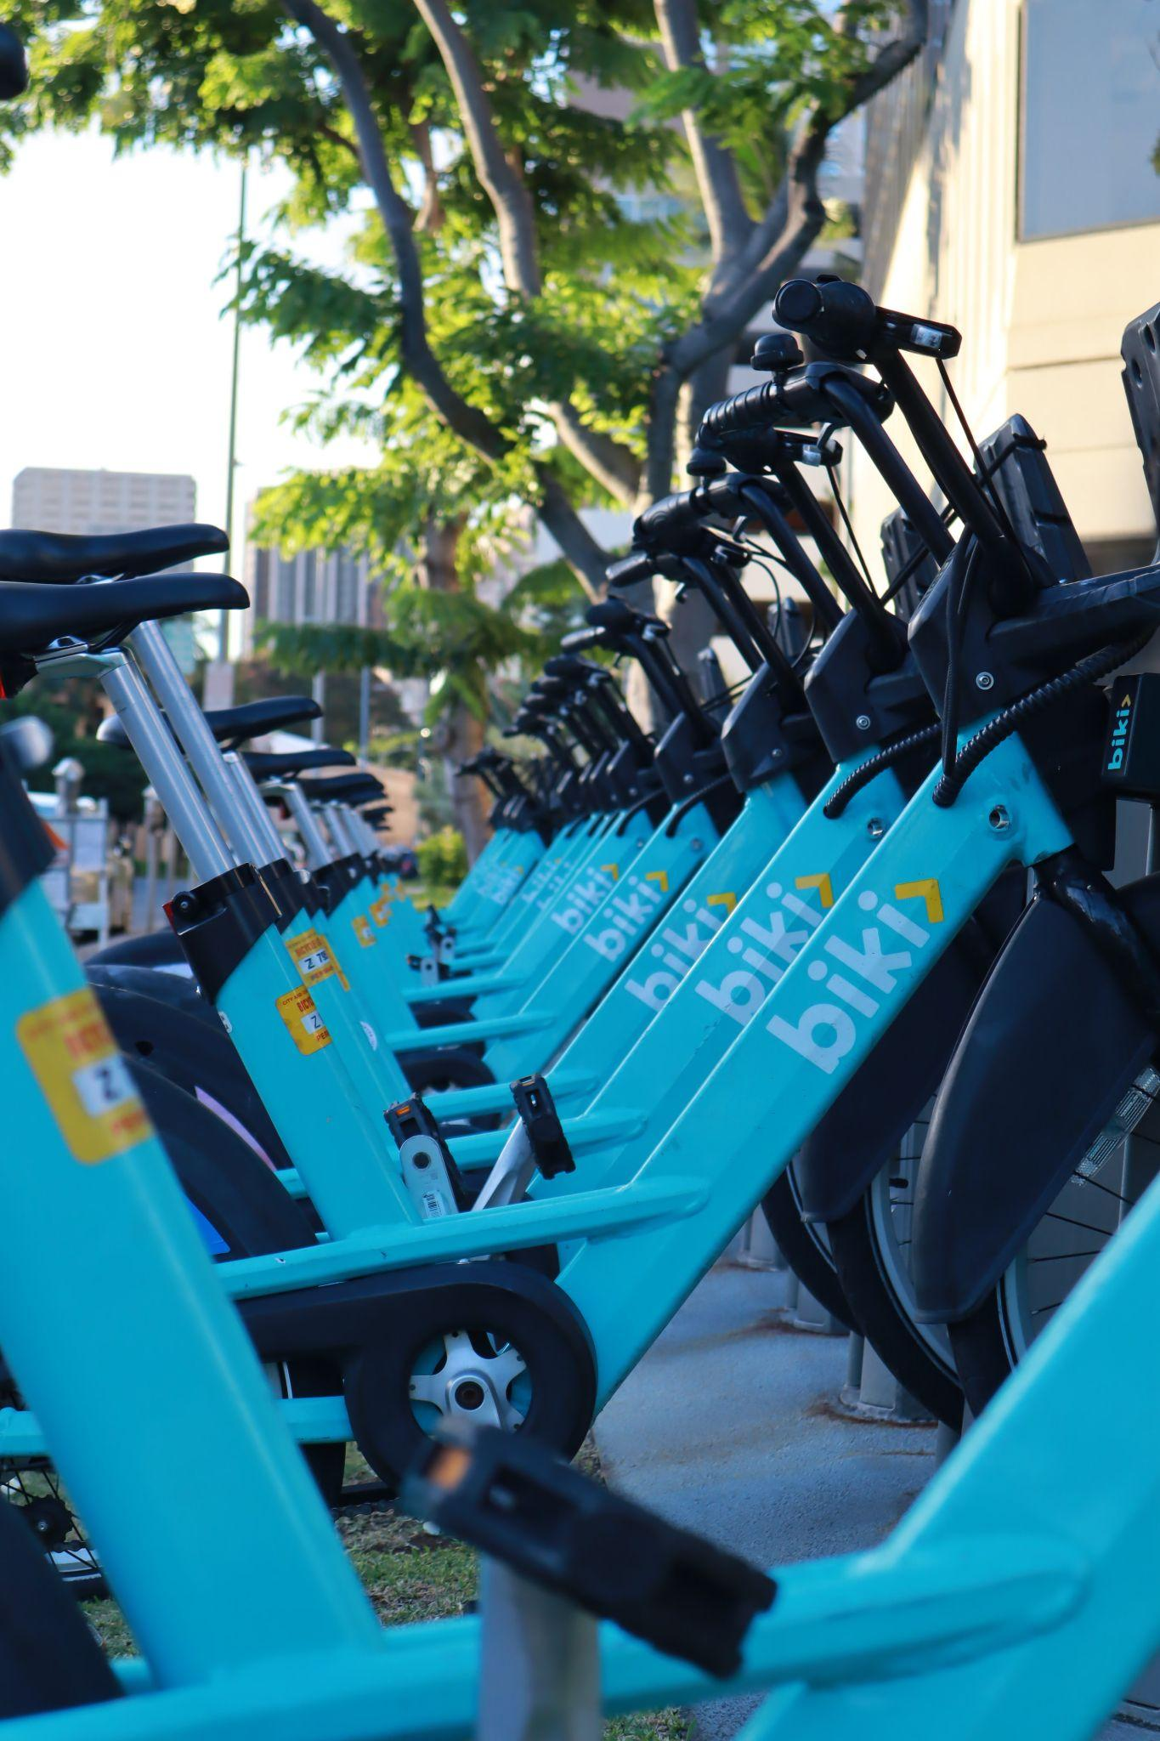
Metrics
1. Average trip duration
2. Busiest days of the week
3. Busiest times of the day
4. Top 3 most used bike station locations
Notes:
Average trip duration and how it trends monthly when comparing casual and annual member riders.
Which days of the week and time of day show the most rides for each group (casual/member) .
Finally, the Top 3 most used bike station locations for each group

Slide 6
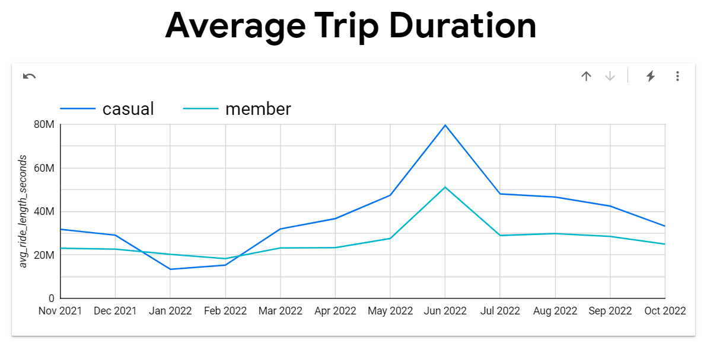
Average Trip Duration
Casuals take longer rides
Ride times increase during the summer months
Casual ride times trend downwards during winter
Notes:
It seems that casual riders consistently take longer rides and it should be assumed they are spending more on average per trip as well. Besides that, casual and annual member riders trend pretty closely with an expected spike in ride duration in the summer months.
The only difference I notice is that casual ride duration trends downwards aggressively starting from December , which I assume is due to the cold weather.
Let's explore further to see why this might be.

Slide 7
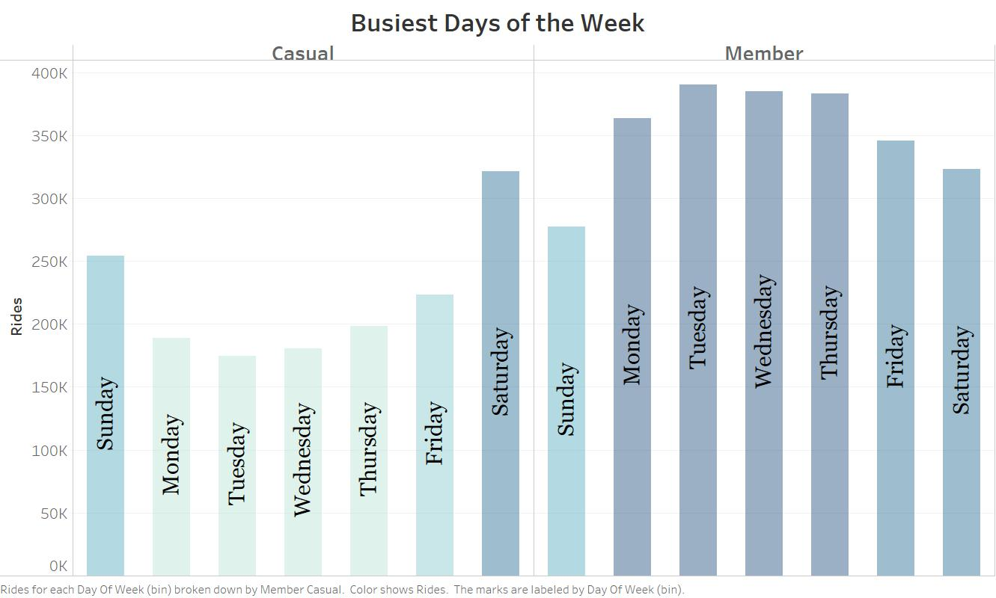
Busiest Days of the Week
Casual riders enjoy weekend rides
Annual members seem to be using the bikes for work
Notes:
From this bar chart, it seems pretty clear that casual members use the bikes for more leisure related activities on the weekends which may explain the longer ride durations and decrease in ride times in the winter.
Annual members seem to be riding more throughout the work week (most likely for their work commute).
Let's see if we can substantiate this by looking at the time of day annual members usually ride.

Slide 8
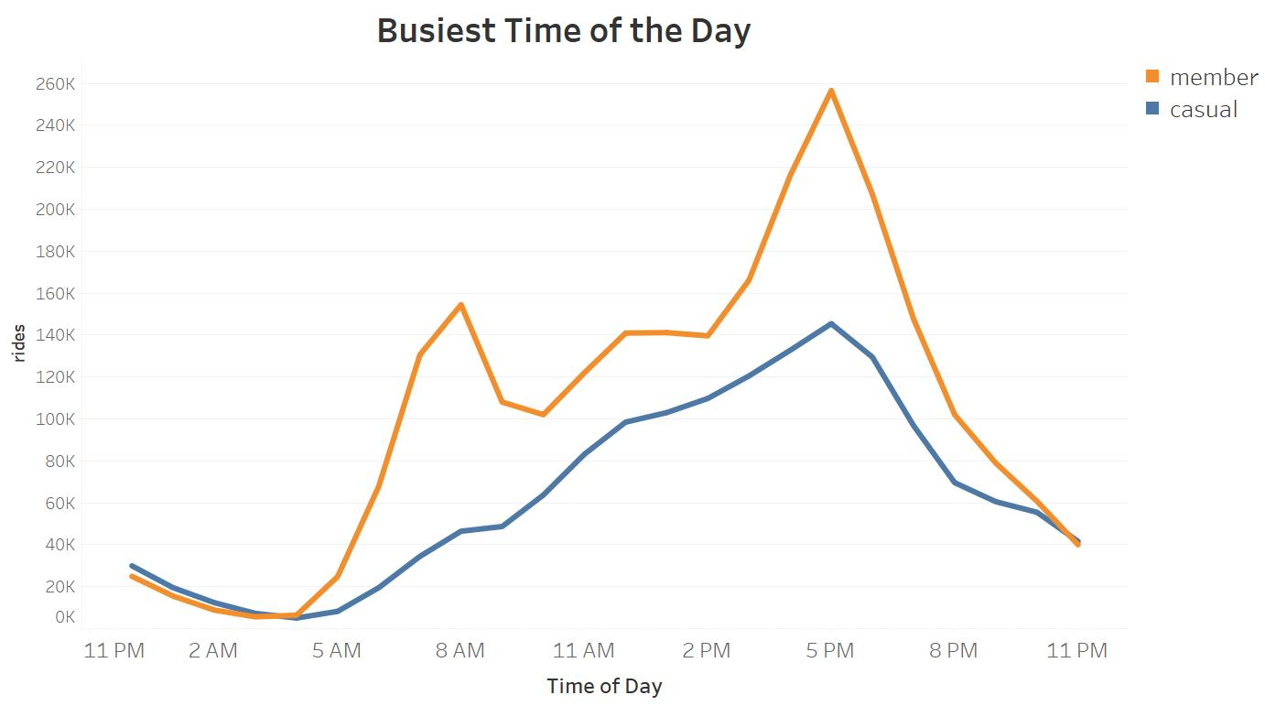
Busiest Time of the Day
Annual members use bikes as part of their work commute
Casuals share similar trends as annual members
Notes:
As expected, annual member ride count spikes at 9 am and 5 pm. Interesting to see that casual riders also spikes around 5 as well.
Casual riders don't have the 9 am spike like the annual members, but this could be an opportunity area to advertise these bikes as a viable primary mode of transportation to and from work.
Let's first make sure these casual riders are starting their rides near major transportation hubs in order to take advantage of the bikes as a work commute option.

Slide 9
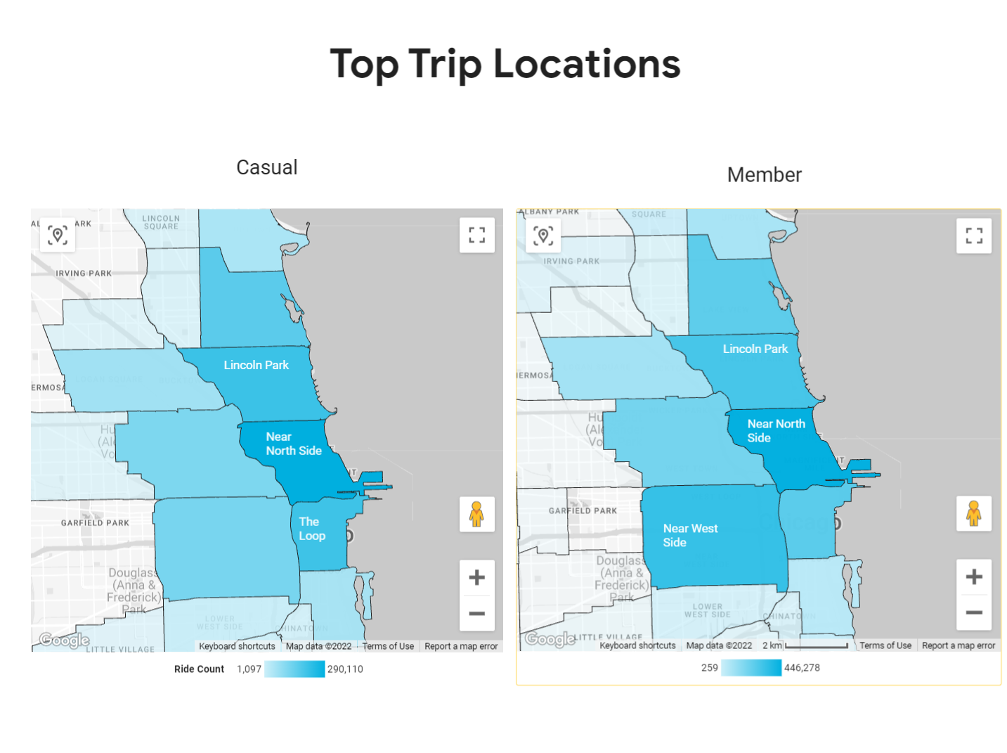
Top Trip Locations
Majority of both riders live in similar communities
Young professionals demographic
Notes:
Now we can clearly see with this filled map that casual and annual members start their rides in almost identical neighborhoods in Chicago.
We can now build a small customer profile of the casual riders based off when and where they like to ride. First off, I feel it’s more than likely a majority of our casual riders live in or near the neighborhoods they are starting these bike trips from.
So let’s take a look at these neighborhoods - The Near North Side is a bustling neighborhood, right next to Chicago’s downtown, that’s known for its residents who are always on the move. With its many cultural, commercial, and nightlife offerings, we can begin to get a sense of the hobbies of our casual riders. (primary source). Also, with a higher share of adults who are in the range of 25-35, and a median household income of around $130k, it’s safe to say the riders in this neighborhood are more than likely young professionals. (source)
The neighborhood of Lincoln Park follows suite, being a nature lover’s dream - with its namesake park “Lincoln Park” , it’s manicured gardens and tons of lakefront green spaces we can see that the casual riders appreciate riding around beautiful natural spaces and enjoying leisurely outdoor activities. ( primary source) .
The Loop with its lakeviews, nightlife, and proximity to big business - falls right in line with the rest of the neighborhoods
Now lets recap everything we’ve learned about our casual and annual riders …

Slide 10
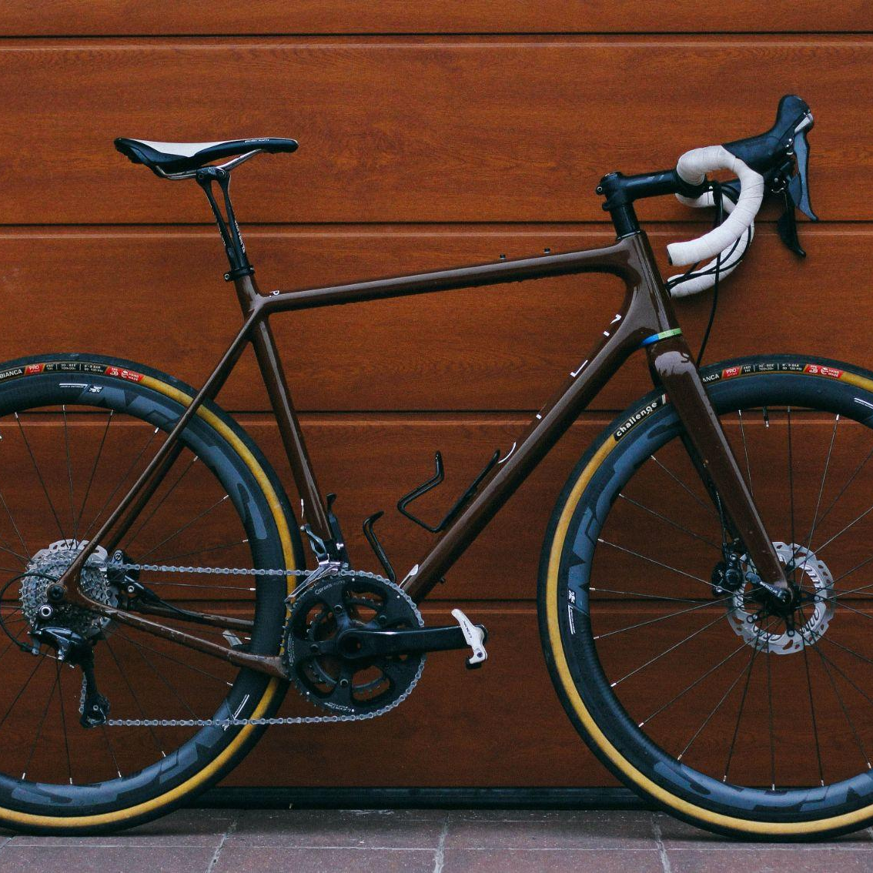
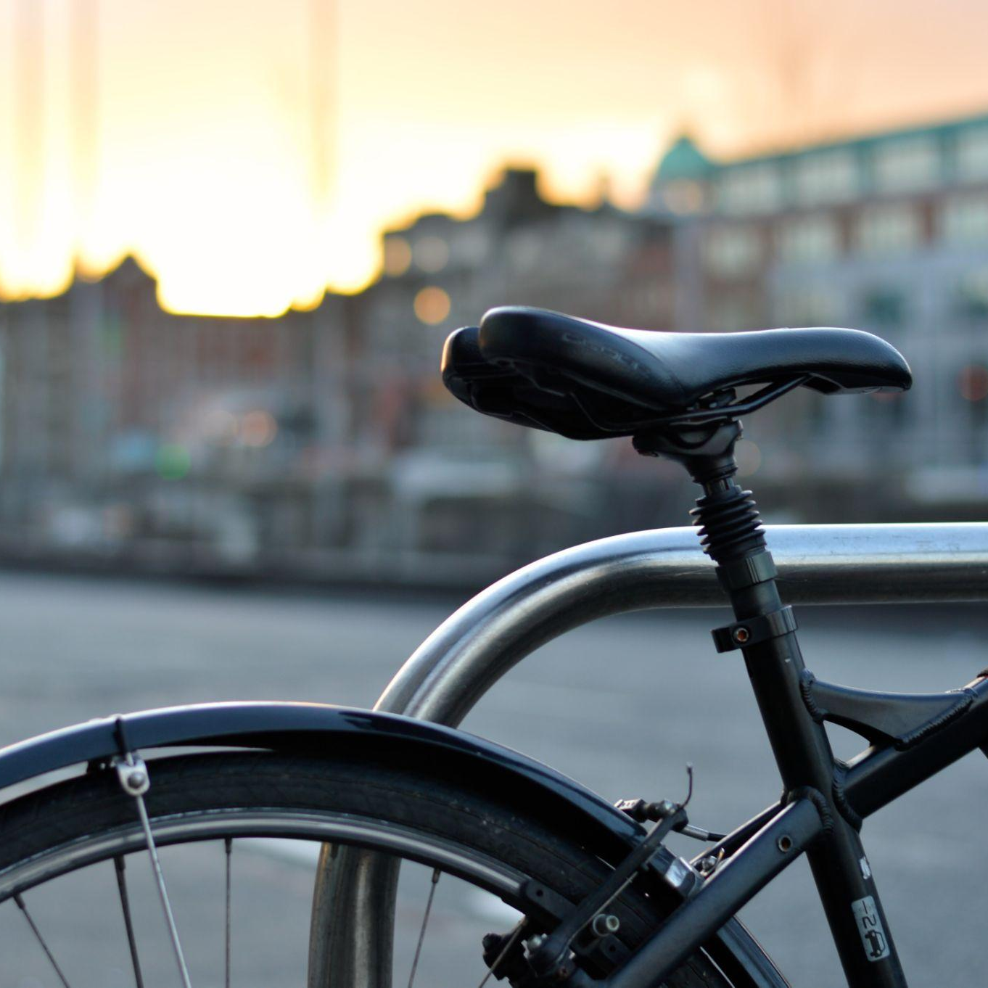
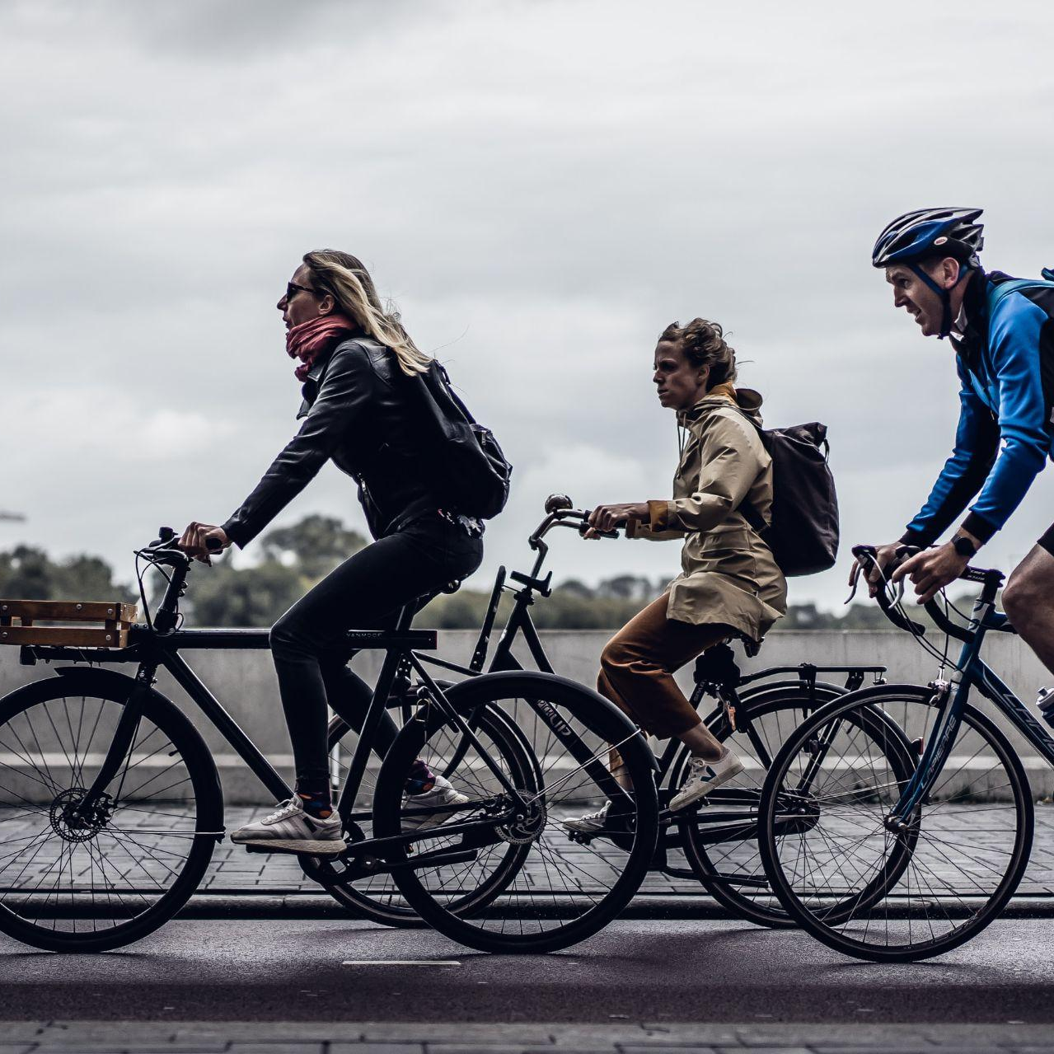
Key Takeaways
There Goes the Neighborhood
Take Your Time
Weekend Warriors
“Workin' 9 to 5”
Casual riders take longer rides on average
Casual riders favor the weekends
Annual Members are utilizing the bikes as a cost effective work commute option.
Both annual and casual riders frequent the same neighborhoods .
Notes:
Casual riders are taking longer trips than their annual rider counterparts
They also tend to ride mostly on the weekends
Annual members are utilizing these bikes for a cost effective and eco friendly commute alternative to work
This is a good thing, because annual riders and casual riders for the most part share the same demographic. So clearly a large portion of the demographic sees our bikes as a solution to their problems. It’s just our job to make the message clear to casual riders.

Slide 11
Conclusion
1) How do casual members and annual members use Cyclist bikes differently ?
Casual riders ride mostly on the weekend
Casual riders take longer rides
Annual members use the bikes for work
2) Why would causal riders buy Cyclistic annual memberships ?
Save money on daily commutes
3) How can Cyclistic use digital media to influence casual riders to become members ?
Utilize Instagram and Twitter to send a tailored message directly to casual riders.
Notes:
So to recap our original business tasks offer my recommendations…
For Question #1 …(Repeat question 1) Casual riders seem to overwhelmingly use the bikes on the weekend. They also take longer trips on average throughout all points of the year in relation to annual members. Annual members seem to be using their bikes mostly for work commutes
For Question #2…(Repeat Question 2)
Seeing as our casual riders are most likely in the young professional demographic of Chicago , they enjoy commutes to nearby outdoor experiences, lounges, and places of work. That being said, riding our bikes would provide them that cost effective and eco friendly commute alternative that this demographic has shown they value.
And finally #3…(Repeat Question 3) Market research has shown Young millennial professionals frequent Instagram and Twitter. Market research also has shown they don’t like to be “sold” a product. They want a quick message that is tailored to problems they face specifically. (primary source) Our message has to quickly advertise it's value to them. I.e "Eco-friendly bike riding that can save you X℅ on your daily commute”

Slide 12
Thank You
Questions ?
Notes:
Any questions ?

